Slide 1


Web Development
Produced
by
Eamonn de Leastar (edeleastar@wit.ie)
Department of Computing, Maths & Physics
Waterford Institute of Technology
http://www.wit.ie
http://elearning.wit.ie

Slide 2
Semantic UI

Slide 3
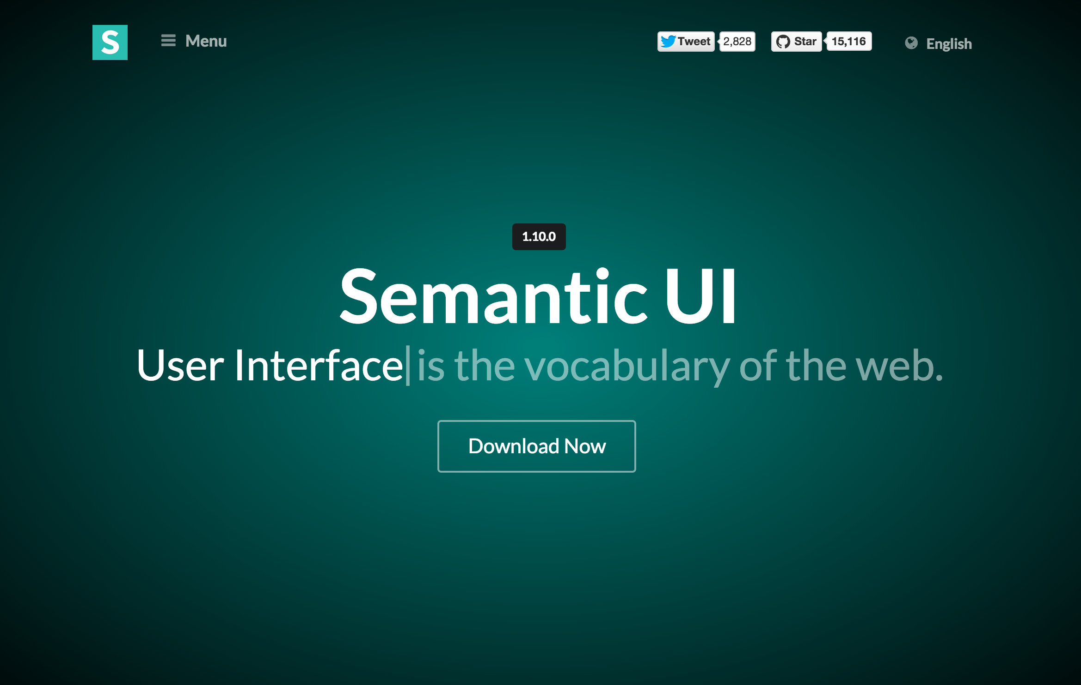
Semantic UI
http://semantic-ui.com/

Slide 4
Semantic UI Components
Elements: The smallest useful homogenous unit for describing page content
Collections : Heterogeneous group of several elements which are usually found together.
Views : Ways of presenting common website content like comments, activity feeds, cards
Modules: Elements where behavior and design are both an essential part of its definition

Slide 5
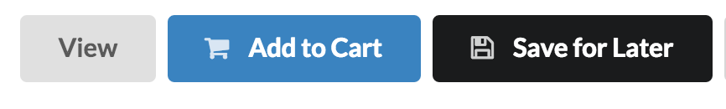
Elements
The smallest useful homogenous unit for describing page content
<div class="ui button">
View
</div>
<div class="ui primary button">
<i class="shop icon"></i> Add to Cart
</div>
<div class="ui secondary button">
<i class="save icon”></i>
Save for Later
</div>

Slide 6
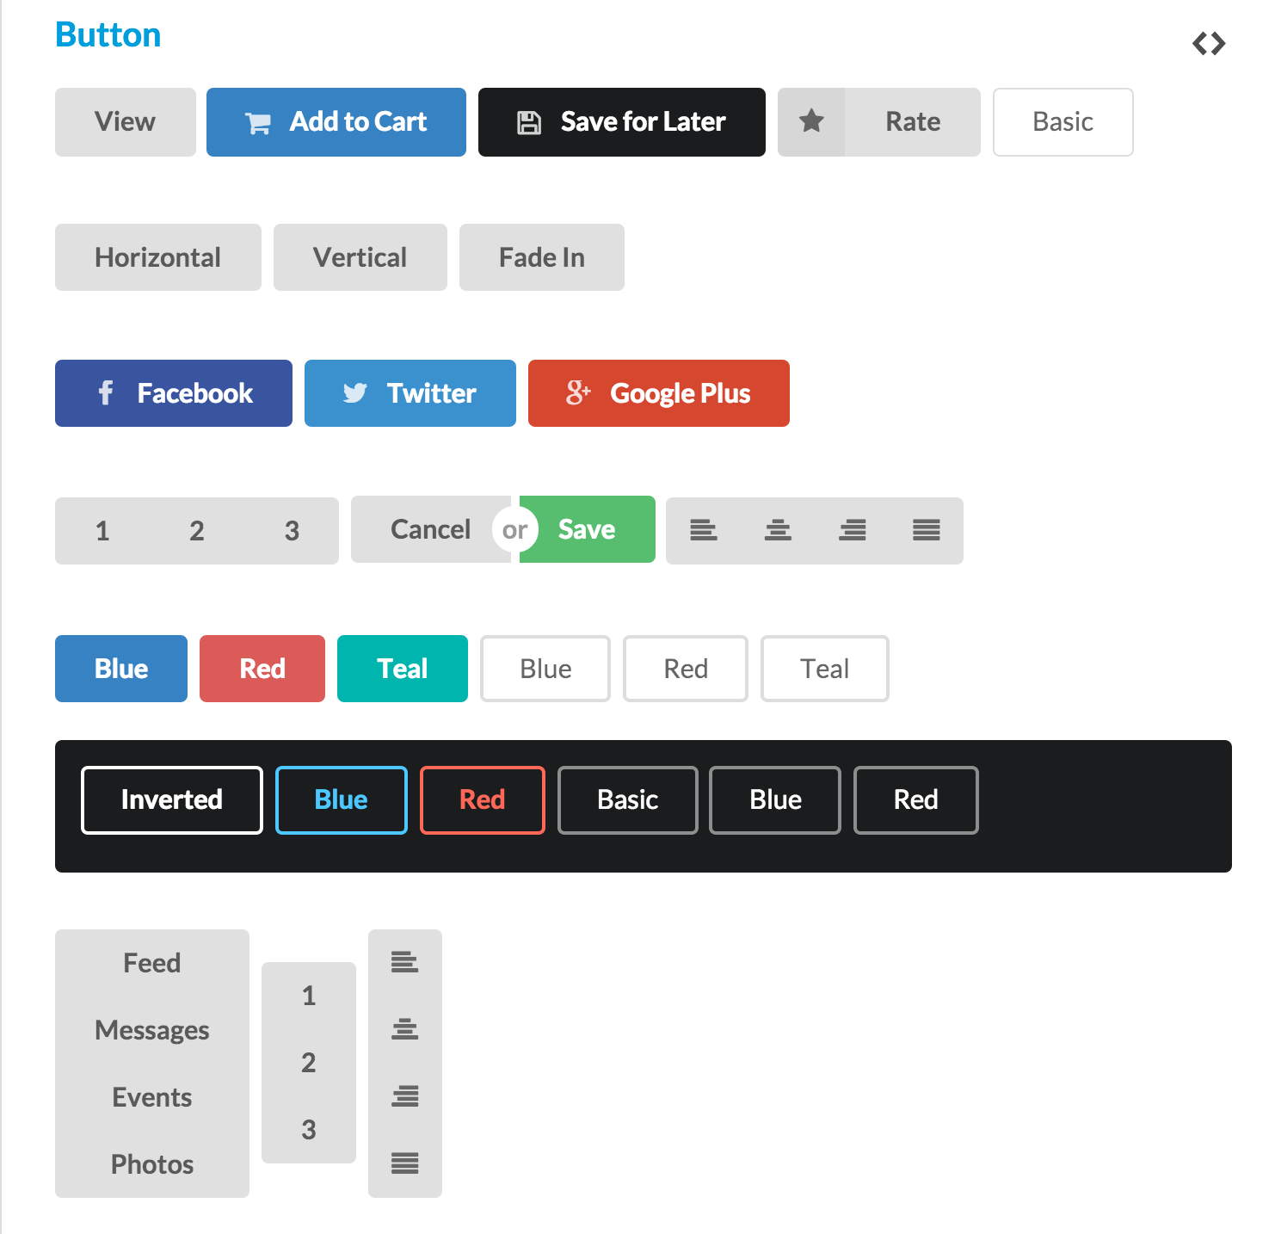
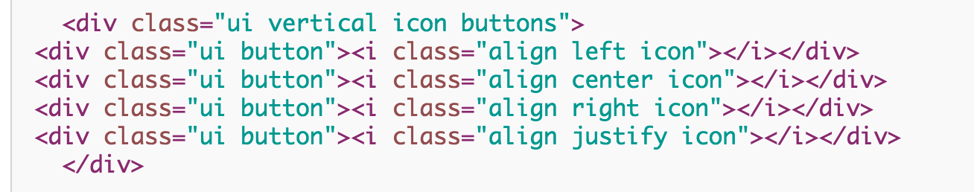

Slide 7
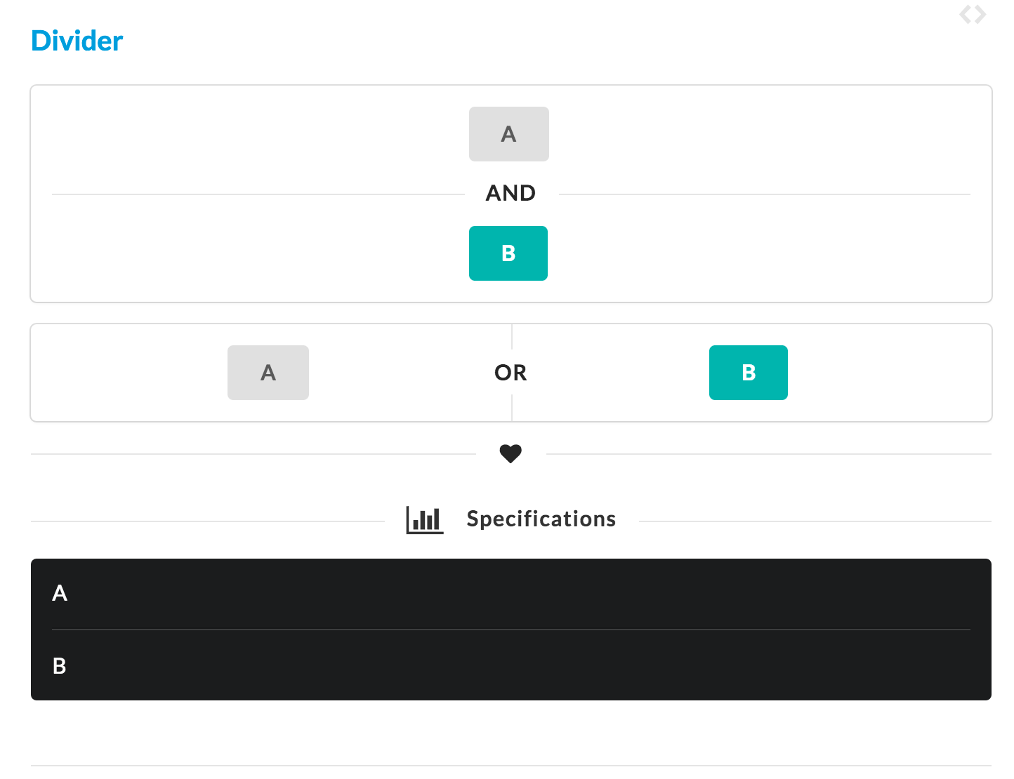
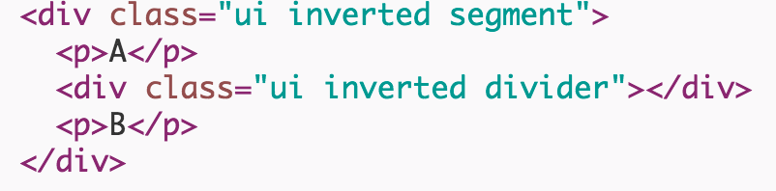

Slide 8
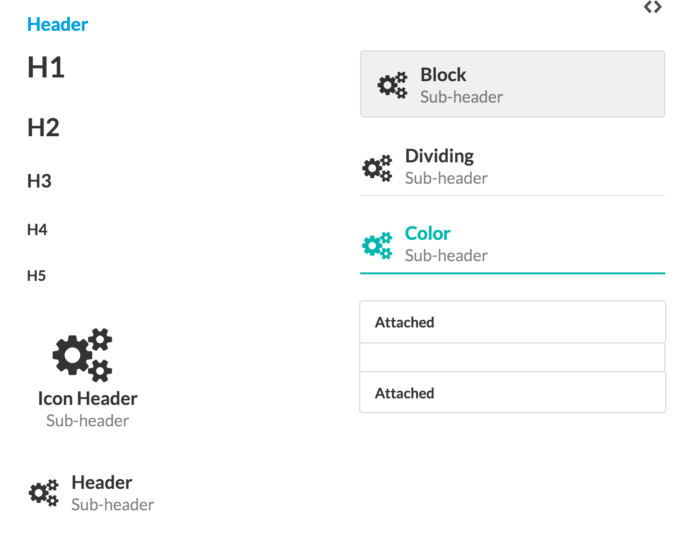
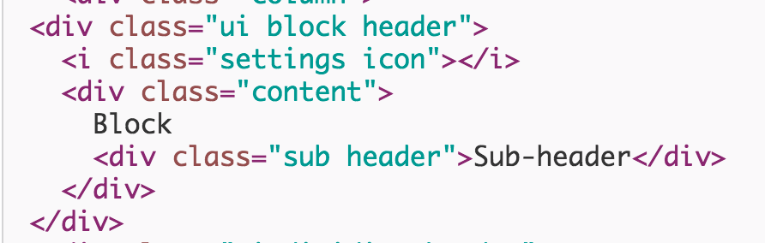

Slide 9
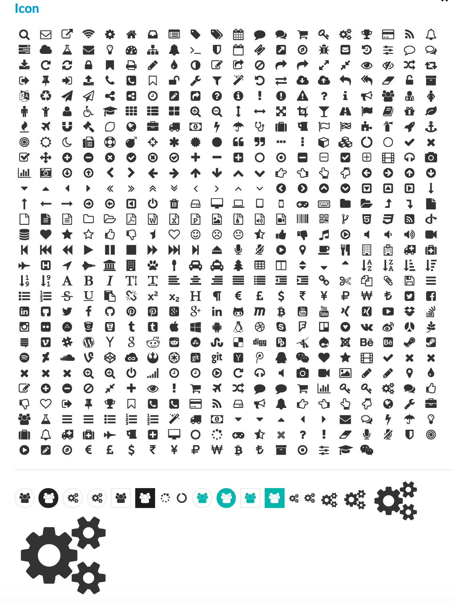
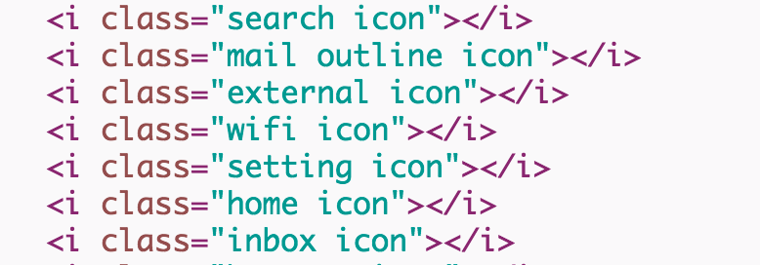

Slide 10
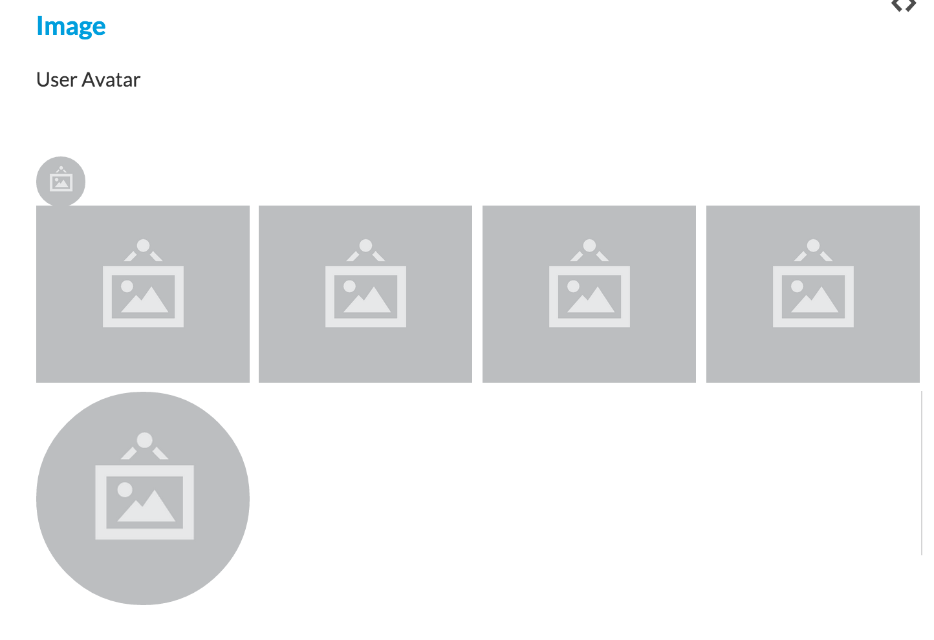
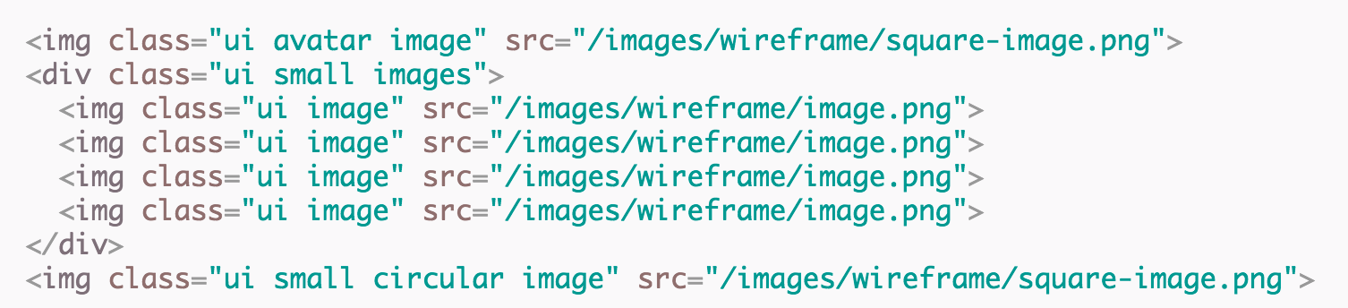

Slide 11
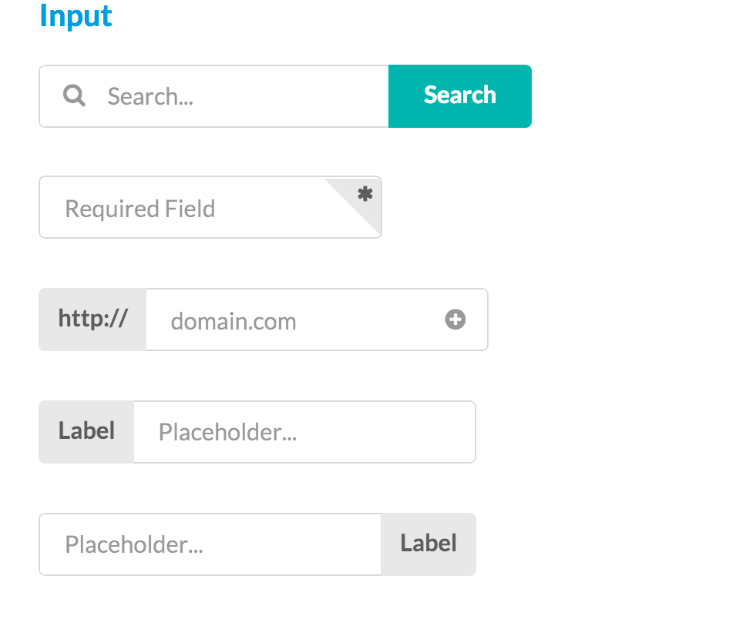
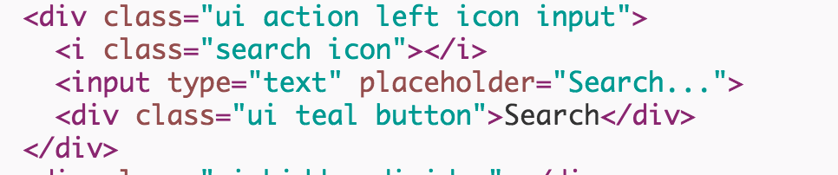

Slide 12
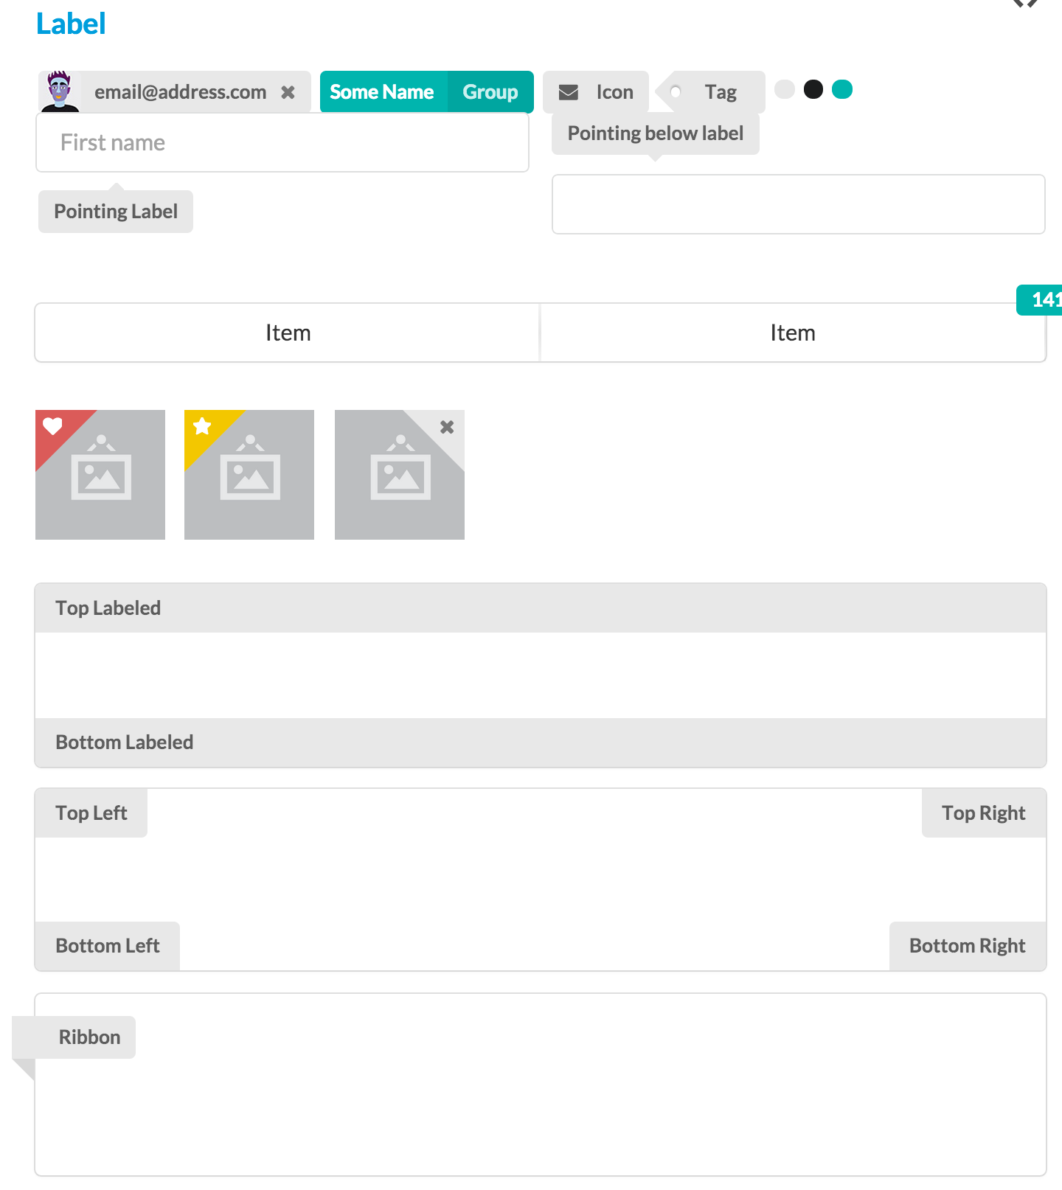

Slide 13
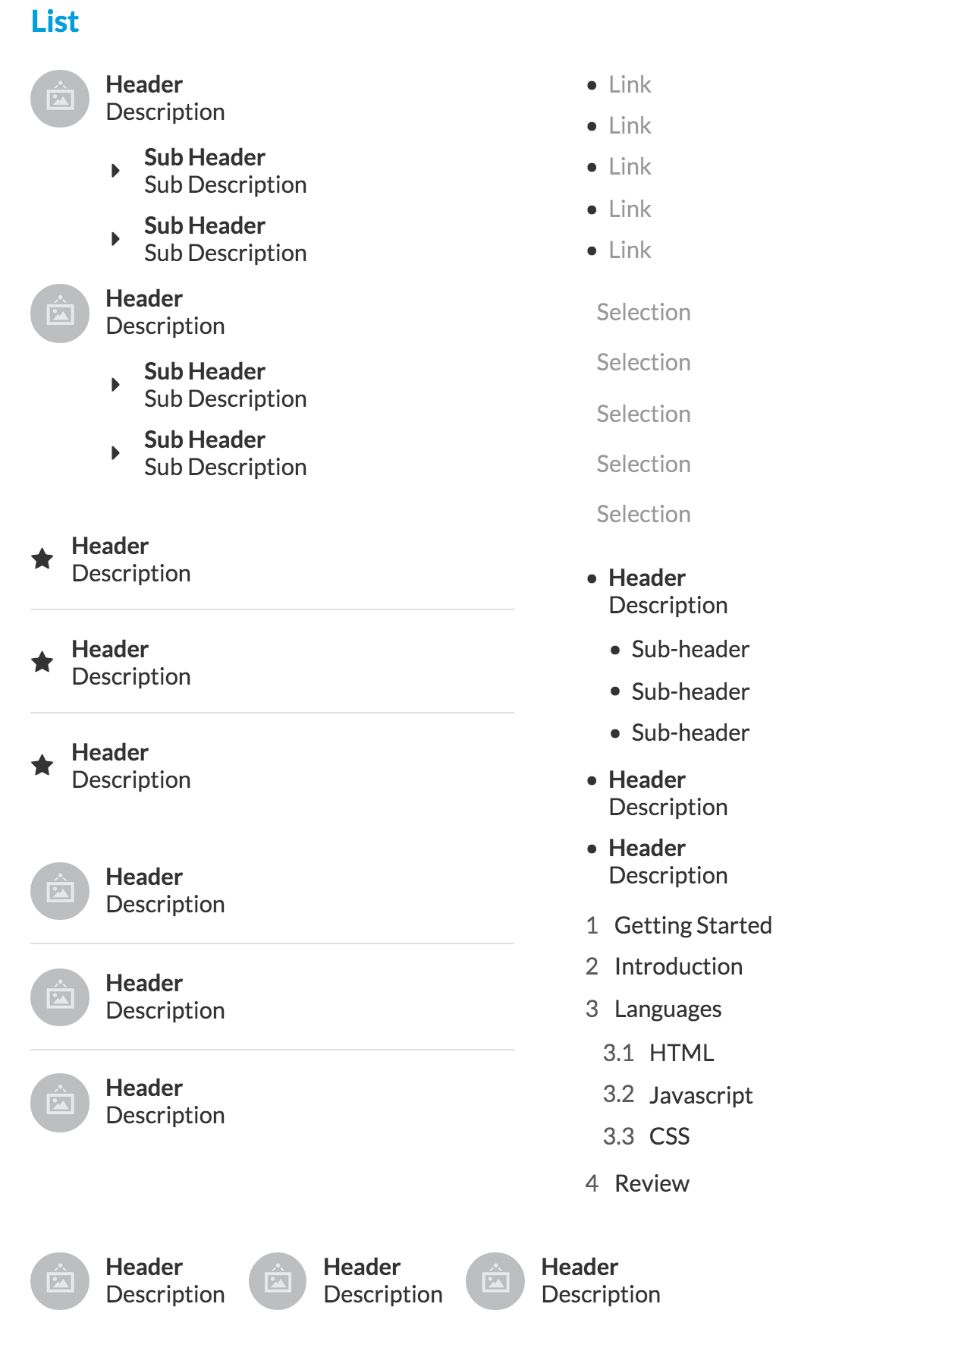

Slide 14
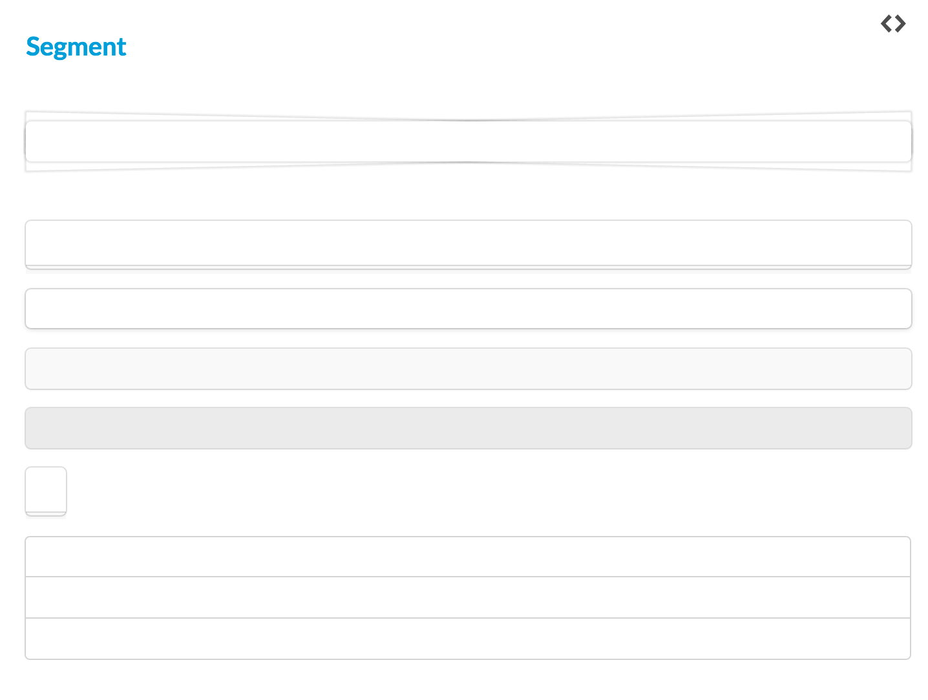

Slide 15
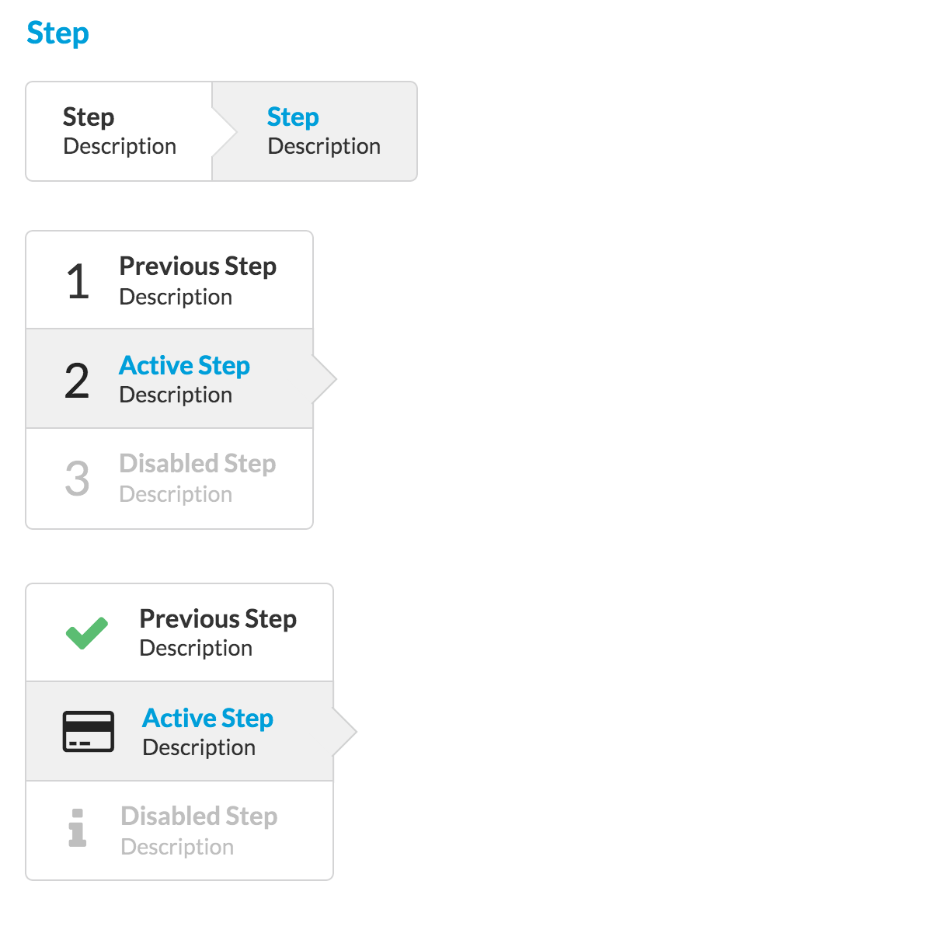

Slide 16
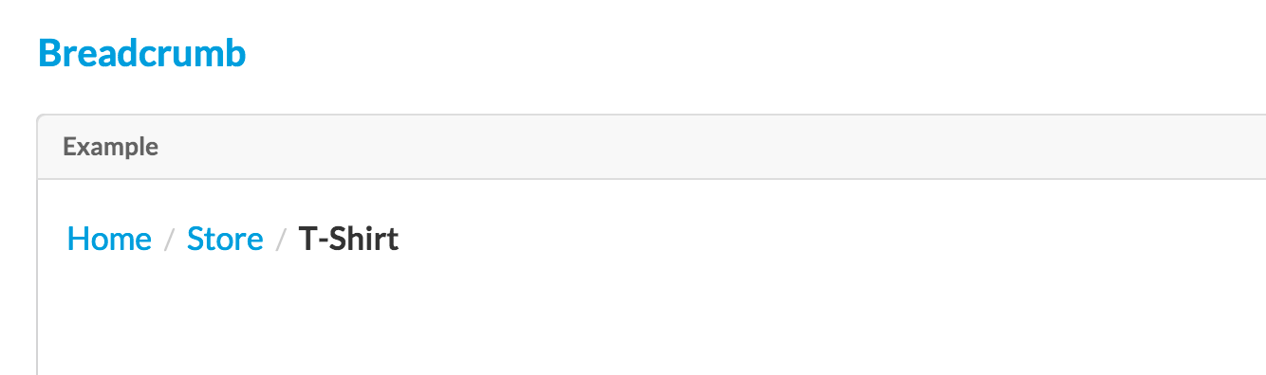
Collections
Heterogeneous group of several elements which are usually found together.
<div class="ui large breadcrumb">
<a class="section">Home</a>
<div class="divider"> / </div>
<a class="section">Store</a>
<div class="divider"> / </div>
<div class="active section">T-Shirt</div>
</div>

Slide 17
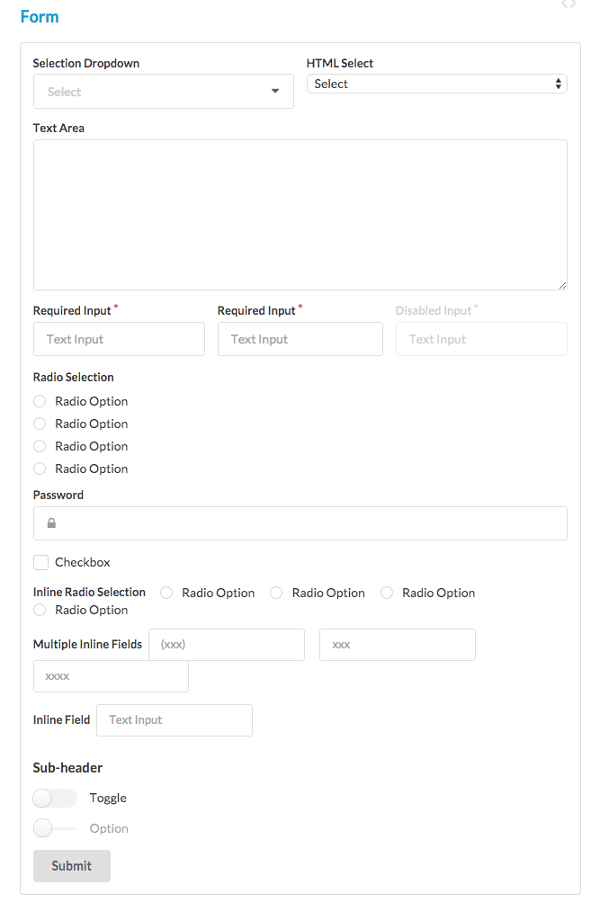
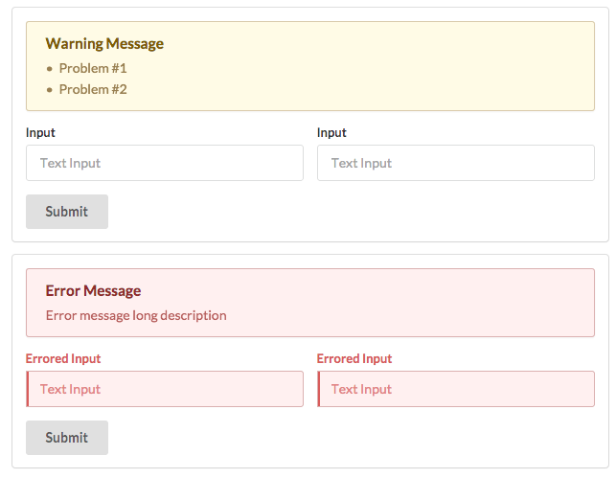

Slide 18

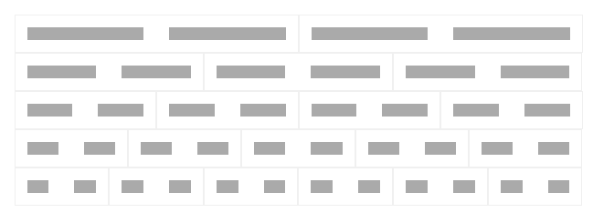

Slide 19
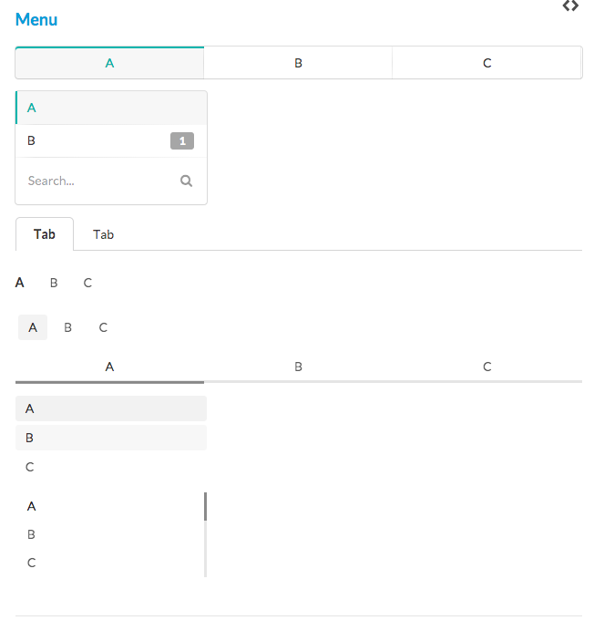

Slide 20
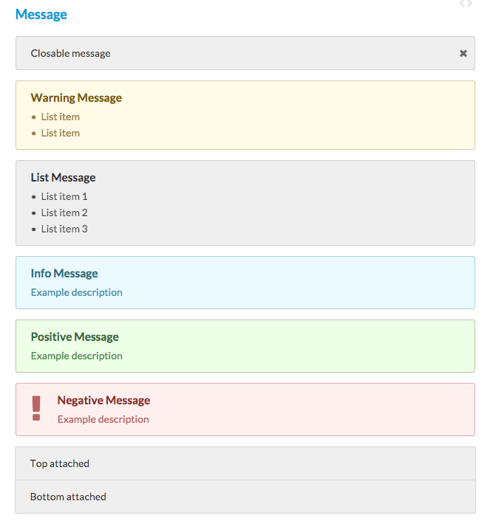

Slide 21
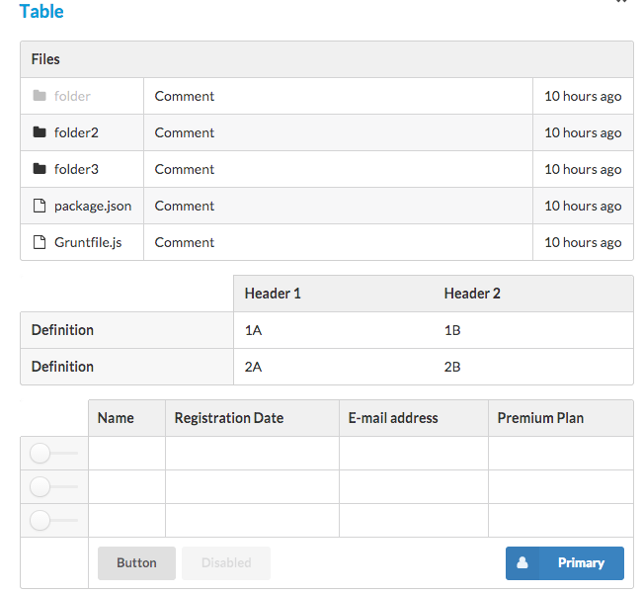

Slide 22
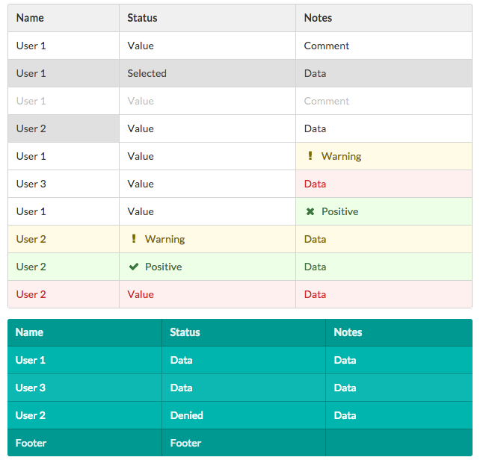

Slide 23
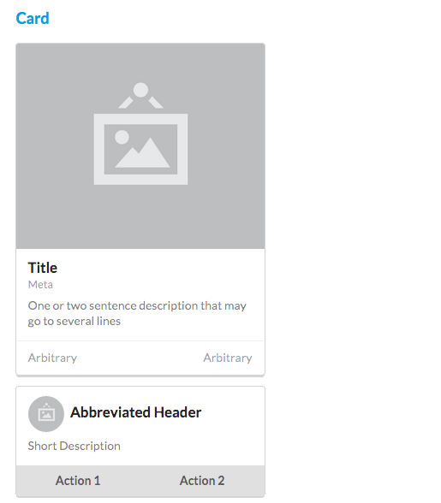
Views
Views : Ways of presenting common website content like comments, activity feeds, cards

Slide 24
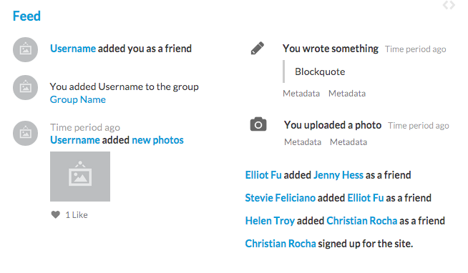

Slide 25
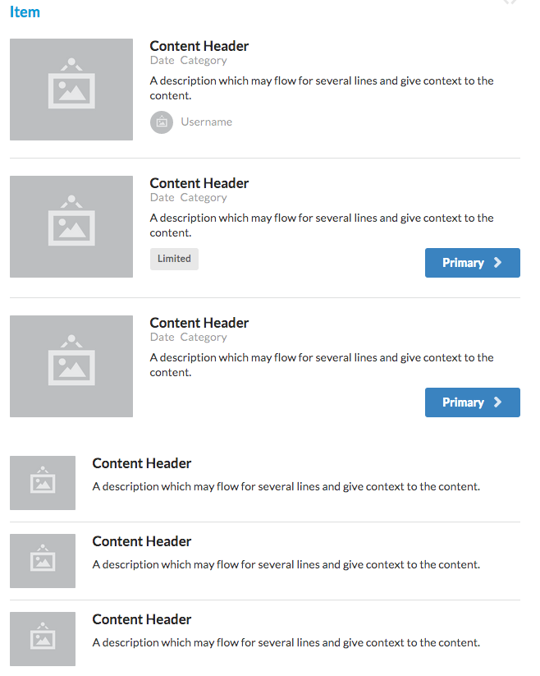

Slide 26
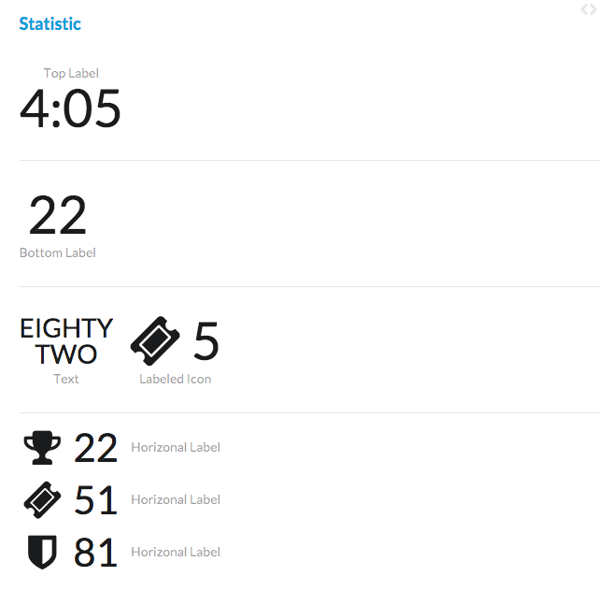

Slide 27
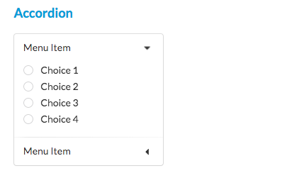
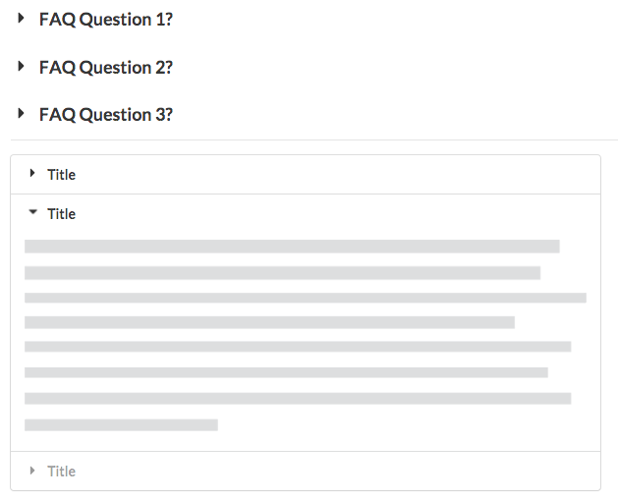
Modules
Modules: Elements where behavior and design are both an essential part of its definition

Slide 28
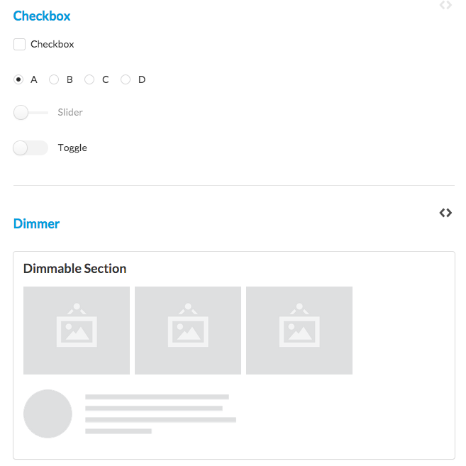

Slide 29
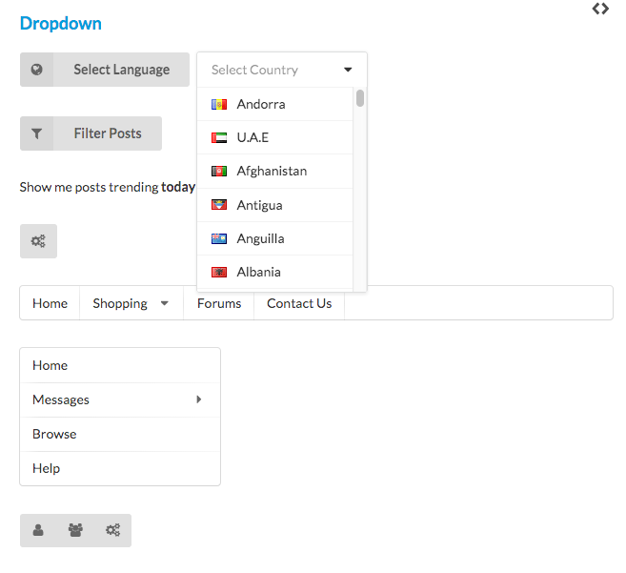

Slide 30
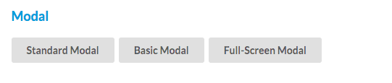
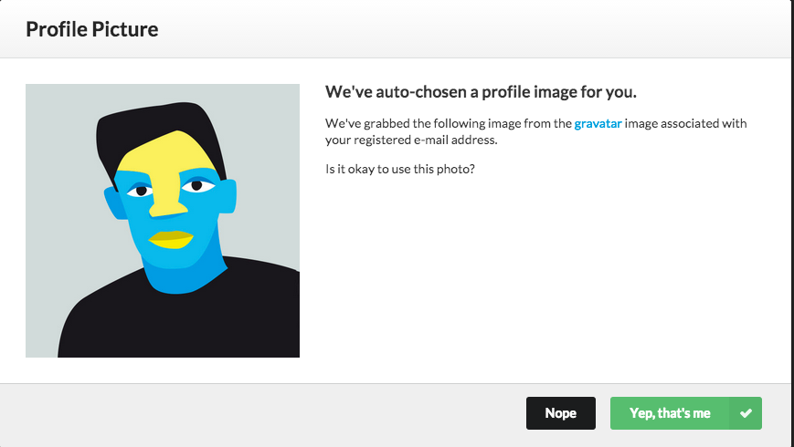

Slide 31
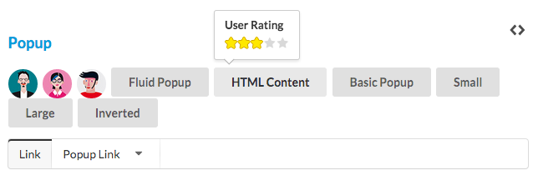
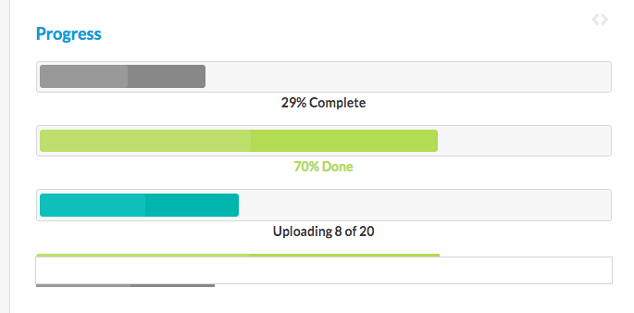

Slide 32
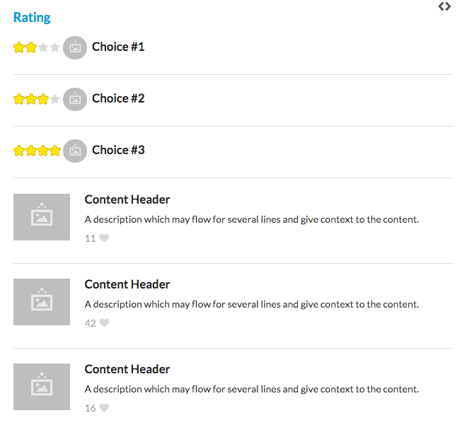

Slide 33
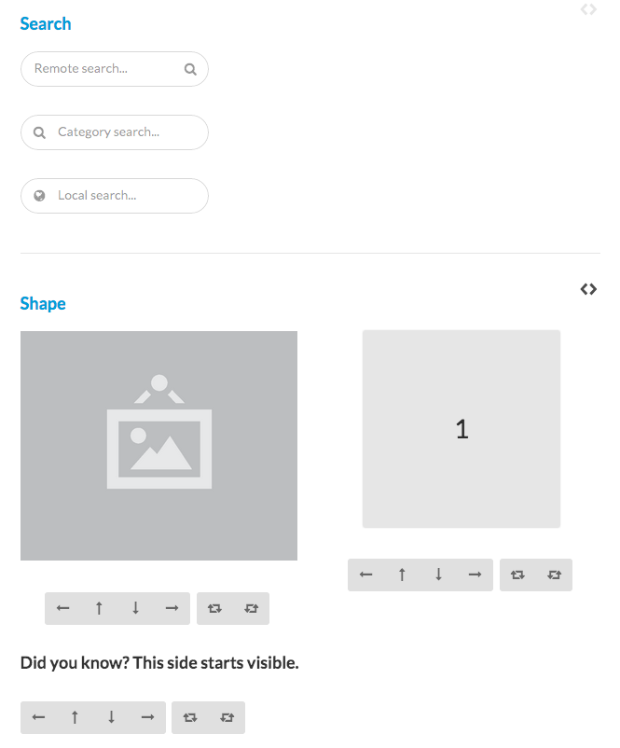

Slide 34
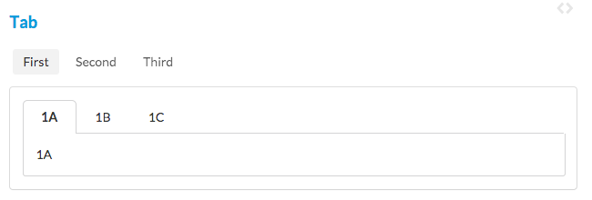

Slide 35
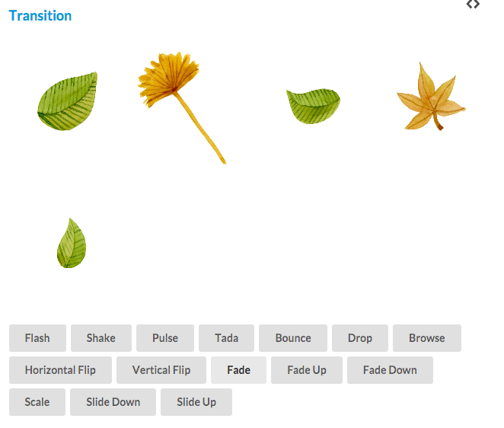

Slide 36
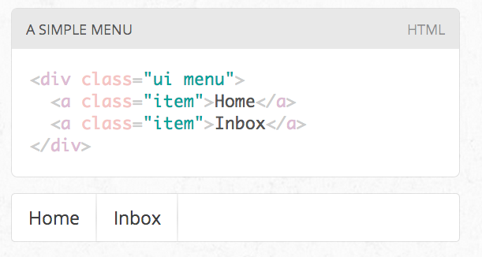
Interfacing Carefully
UI definitions in Semantic are given the class name ui.

Slide 37
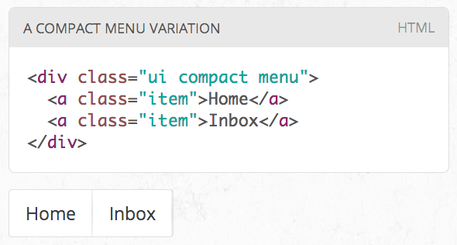
Changing an Element
Class names in Semantic always use single english words.
If a class name is an adjective it is either a type of element or variation of an element.
CSS definitions always define adjectives in the context of a noun. In this way class names cannot pollute the namespace.

Slide 38
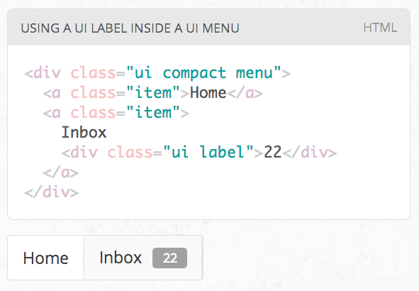
Combining an Element
All UI definitions in semantic are stand-alone, and do not require other components to function.
However, components can choose to have optional couplings with other components.
For example you might want to include a badge inside a menu. A label inside of a menu will automatically function as a badge

Slide 39
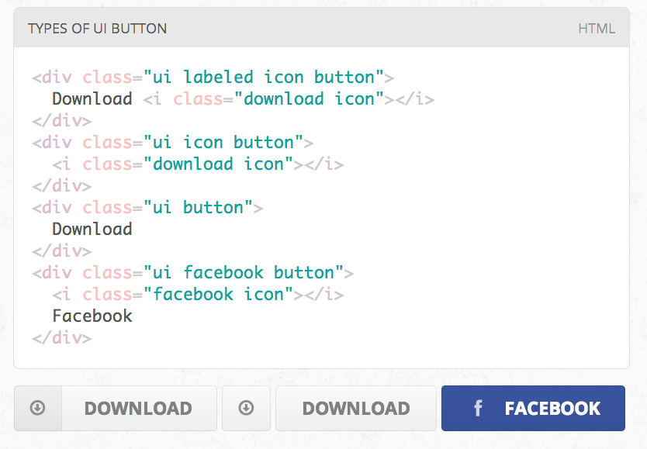
Types / Variations
A ui definition in Semantic usually contains a list of mutually exclusive variations on an element design.
A type is designated by an additional class name on a UI element

Slide 40
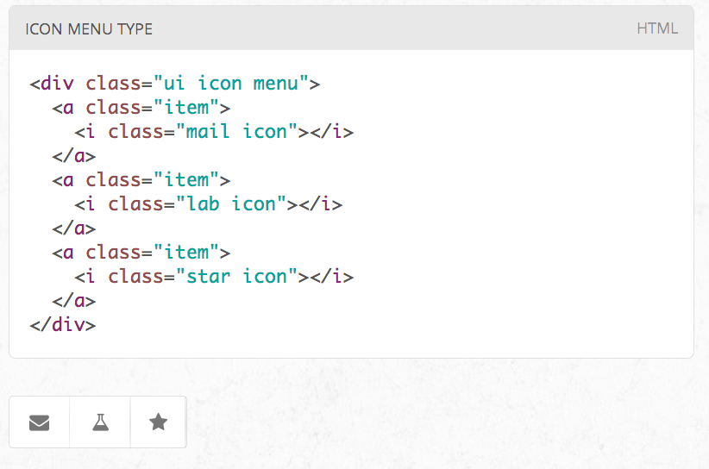
Types / Content
Types may require different html structures to work correctly.
For example, an icon menu might expect different content like icons glyphs instead of text to be formatted correctly

Slide 41
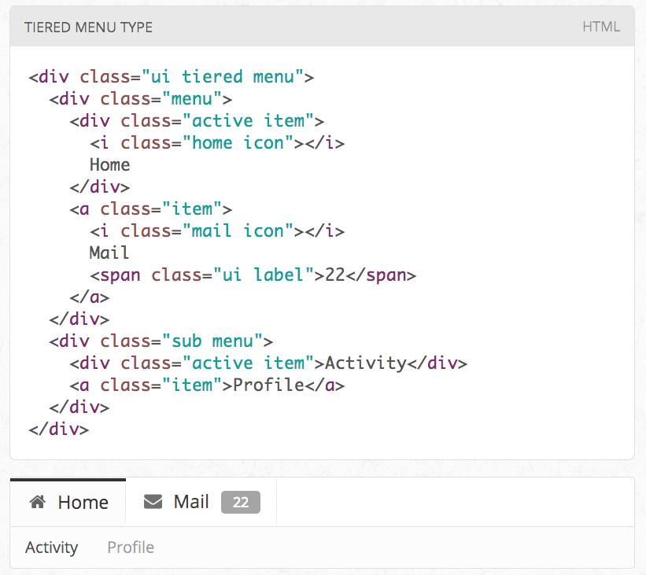
Types / HTML Differences
Types may also each require slightly different html.
For example, a tiered menu needs html specified for a sub menu to display itself correctly

Slide 42
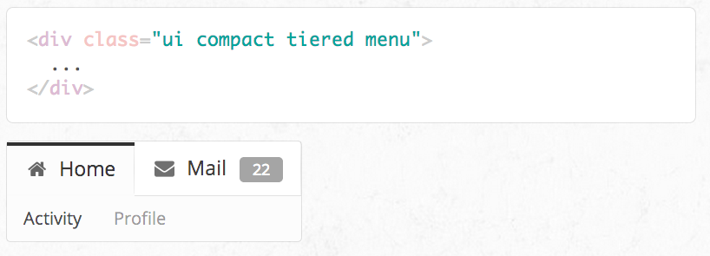
Variations
A variation alters the design of an element but is not mutually exclusive.
Variations can be stacked together, or be used along with altering an element's type.
For example, having wide menus that take up the full width of its parent may sometimes be overwhelming. You can use the compact variation of a menu to alter its format to only take up the necessary space.

Slide 43
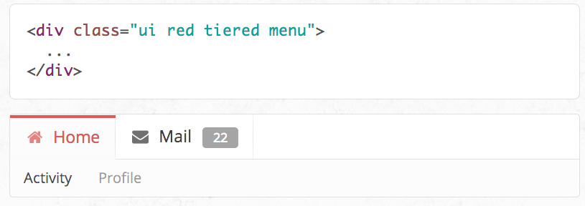
Intersecting Variations
The definition for the variation red contains css specifically for describing the intersection of both red and inverted.

Slide 44
Whats Different?

Slide 45
Build Responsive Layouts Easier
Designed Completely with EM
Every component is defined using em and rem so that components can be resized simply on the fly.
Want a menu to get smaller on mobile? Simply have it's font-size change using a media query.

Slide 46
Self Explanatory
Descriptive not Prescriptive
Writing front end code shouldn't require learning the naming or programming conventions of a particular developer.
Instead of using short-hand, or codifying naming conventions, Semantic uses simple, common language for parts of interface elements, and familiar patterns found in natural languages for describing elements.

Slide 47
Tag Agnostic
Use whatever html tags you please.
Interface definitions in Semantic are tag ambivalent.
That means you can use div, article, section, span without affecting the display of the element.
Special tags like a, table, td still carry special meaning in certain circumstances however.

Slide 48
Powerful tools for expressing groups and collections.
Don't repeat yourself
In English it's much easier to say "There are three tall men" than "There is a tall man, a tall man and a tall man".
In Semantic element definitions can be expressed in groups have shared attributes like size, color, type avoiding repetitive declarations.

Slide 49
Portable and self-contained.
Using Semantic doesn't mean adopting an entire framework, or rewriting your code base
Semantic components are written in a singular style, but are not part of mandated overarching library. Only like a couple components? No problem, use only what you need.
UI components in Semantic also define optional and required couplings with other components where their usage intersect. That means for example, a popup can check for the existence of CSS animation component before using the fallback javascript animations.

Slide 50
Shared language, different implementations
Restyle your site without Restructuring it
Describing your site's content using a common language like Semantic allows other developers to create UI definitions to match one shared vocabulary.
This means you can redesign your website without retooling your html.
Simply alter the look and feel of your UI using a different UI style definition.

Slide 51

Except where otherwise noted, this content is licensed under a Creative Commons Attribution-NonCommercial 3.0 License.
For more information, please see http://creativecommons.org/licenses/by-nc/3.0/

